Slide 1
1:1-12

Slide 2
1:1-12
Wichita North High School
“Go Redskins”
Class of ‘69

Slide 3
1:1-12

Slide 4
1:1-12
Great fire of Rome AD 64
Peter’s martyrdom c. AD 68
1st persecution of Christians
AD 63
AD 64
AD 65
AD 66
AD 67
AD 68
1 Peter written c. AD 65-66
2 Peter written c. AD 67

Slide 5
1:1-12

Slide 6
1:1-12
1 Peter 1:1–12 ~ ¹ Peter, an apostle of Jesus Christ,
To the pilgrims of the Dispersion in Pontus, Galatia, Cappadocia, Asia, and Bithynia, ² elect according to the foreknowledge of God the Father, in sanctification of the Spirit, for obedience and sprinkling of the blood of Jesus Christ:
Grace to you and peace be multiplied.
³ Blessed be the God and Father of our Lord Jesus Christ, who according to His abundant mercy has begotten us again to a living hope through the resurrection of Jesus Christ from the dead,

Slide 7
1:1-12
1 Peter 1:1–12 ~ ⁴ to an inheritance incorruptible and undefiled and that does not fade away, reserved in heaven for you, ⁵ who are kept by the power of God through faith for salvation ready to be revealed in the last time.
⁶ In this you greatly rejoice, though now for a little while, if need be, you have been grieved by various trials, ⁷ that the genuineness of your faith, being much more precious than gold that perishes, though it is tested by fire, may be found to praise, honor, and glory at the revelation of Jesus Christ,

Slide 8
1:1-12
1 Peter 1:1–12 ~ ⁸ whom having not seen you love. Though now you do not see Him, yet believing, you rejoice with joy inexpressible and full of glory, ⁹ receiving the end of your faith—the salvation of your souls.
¹⁰ Of this salvation the prophets have inquired and searched carefully, who prophesied of the grace that would come to you, ¹¹ searching what, or what manner of time, the Spirit of Christ who was in them was indicating when He testified beforehand the sufferings of Christ and the glories that would follow.

Slide 9
1:1-12
1 Peter 1:1–12 ~ ¹² To them it was revealed that, not to themselves, but to us they were ministering the things which now have been reported to you through those who have preached the gospel to you by the Holy Spirit sent from heaven—things which angels desire to look into.

Slide 10
1:1-12

Slide 11
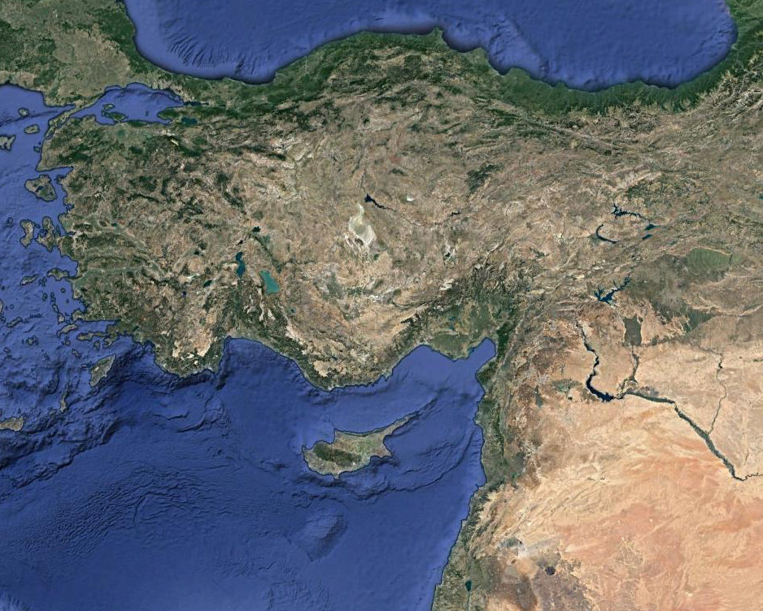
1:1-12
Dispersion ~ diaspora – to cast seeds
Bithynia
Pontus
Turkey
Cappadocia
Asia
Galatia

Slide 12
1:1-12
pilgrims ~ NASB, aliens
KJV, NIV ~ strangers

Slide 13
1:1-12

Slide 14
1:1-12
elect ~ eklektos – choose
foreknowledge ~ prognōsis

Slide 15
1:1-12

Slide 16
1:1-12
Justification ~ 1 Cor. 15:1-2a
1 Cor. 15:1-2a ~ ¹ Moreover, brethren, I declare to you the gospel which I preached to you, which also you received and in which you stand, ^{2a} by which also you are saved,

Slide 17
1:1-12
Justification ~ 1 Cor. 15:1-2a
Glorification ~ 1 Cor. 3:15
1 Cor. 3:15 ~ If anyone’s work is burned, he will suffer loss; but he himself will be saved, yet so as through fire.

Slide 18
1:1-12
Justification ~ 1 Cor. 15:1-2a
Sanctification ~ 1 Cor. 1:18
Glorification ~ 1 Cor. 3:15
1 Cor. 1:18 ~ For the message of the cross is foolishness to those who are perishing, but to us who are being saved it is the power of God.

Slide 19
1:1-12

Slide 20
1:1-12
sprinkling … not washing
Initiation of the covenant (Ex. 24:5-8)
Anointing the priests (Ex. 29:19-21)
Cleansing of lepers (Lev. 14:1-9)

Slide 21
1:1-12

Slide 22
1:1-12
begotten us again ~ anagennaō
ana ~ again; gennaō ~ to be born
Latin ~ regenerō (regenerate)
John 3:3 ~ Jesus answered and said to him, “Most assuredly, I say to you, unless one is born again, he cannot see the kingdom of God.”
gennaō anōthen ~ from above or again

Slide 23
1:1-12
John 14:6 ~ Jesus said to him, “I am the way, the truth, and the life. No one comes to the Father except through Me.”
An absolute statement is either true or false
It cannot be both
There are no absolute statements
My truth is just as good as your truth

Slide 24
1:1-12
Objective truth ~ empirical, measurable, demonstrable – founded upon fact
Subjective truth ~ emotional, expressive, arousing – founded upon feeling
Objective truth
Subjective truth

Slide 25
1:1-12

Slide 26
1:1-12
+
=
Sound doctrine
Faith
Sound practice
Dead orthodoxy
Chicken with its head chopped off
Orthodoxy becomes Orthopraxy
Ps. 25:15 ~ My eyes are ever toward the Lord, for He shall pluck my feet out of the net.

Slide 27
1:1-12

Slide 28
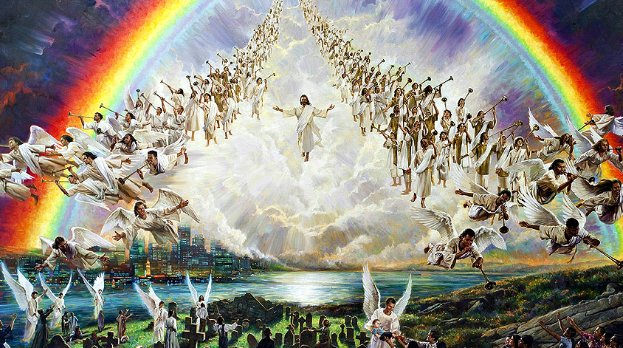
1:1-12
2000 yr.

Slide 29
1:1-12

Slide 30
1:1-12
Heb. 11:40 ~ God having provided something better for us, that they should not be made perfect apart from us.
Old Testament Prophets’ scope of fulfilled prophecy
approx. 4000 yr.
1500 BC
500 BC
AD 500
AD 1500
approx. 1500 yr.
Church’s scope of fulfilled prophecy

Slide 31
1:1-12
We have the completed canon of Scripture
We see Christ’s redemption as historical
We are regenerated
We have the permanent indwelling of the Holy Spirit
We have the Bride of Christ

Slide 32
1:1-12

